Slide 1
SelfKey
Sravya Jarugu Akshay Mukkavilli Sai Kira Reddy Gade Mounika Mekapothula

Slide 2
Problem: You do not own your own identity
The shift from paper to digital computing and Internet are some of the most fundamental changes of recent modern history
Despite the advancements, the identity systems we rely upon today are currently paper-based, nationally-driven, government identity systems and do not leverage the power of Internet
Most identity systems are centrally planned and managed, do not integrate or link to other systems, and do not place the identity owner in a place of entitlement and power.
Many centralized identity systems have very serious security issues. The recent Equifax data breach where the personal data of up to 143 million individuals may have been compromised highlights the vulnerability of centralized databases

Slide 3
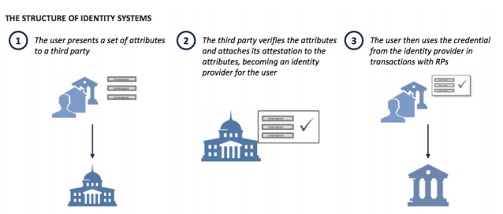
Parties in an Identity Transaction
Identity Owner(IO)
Identity Claim Issuer
Relying Party(RP)

Slide 4
Limitations of a Centrally Managed Identity System
Security
Restricted Access
KYC regulatory requirements
KYC: Know Your Customer
It is the process of a business identifying and verifying the identities of a customer. The time and effort expended by one relying party to perform KYC validation checks cannot be reused or recycled and is not leveraged in future requests.

Slide 5
Solution: “SelfKey” Self-Sovereign Digital Identity Ecosystem
The idea is simple: The users will be at the center of their identity management process, a concept known as Self-Sovereign IDentity (SSID).
SelfKey overcomes the limitations of centralized identity systems, helps achieve compliance KYC regulations
SelfKey is also building a bridge to a better world - one with digitally signed verified identity claims, data minimization, proof of individuality, proper governance, and a user-centric identity system

Slide 6
How SelfKey works for the Individual U ser
A new user would simply download the SelfKey Wallet application on a personal device. Identity data is stored locally, on the device
The first thing that a user needs to store in this container is a public/private key pair (also known as a SelfKey). This SelfKey will become the user’s digital “pen”.
SelfKey has enormous benefits beyond a traditional username and password.
Each SelfKey is unique to its owner. Where a username/password combination is stored in a third party’s database, a SelfKey user would never share their private key - this would always remain a secret to the user.

Slide 7
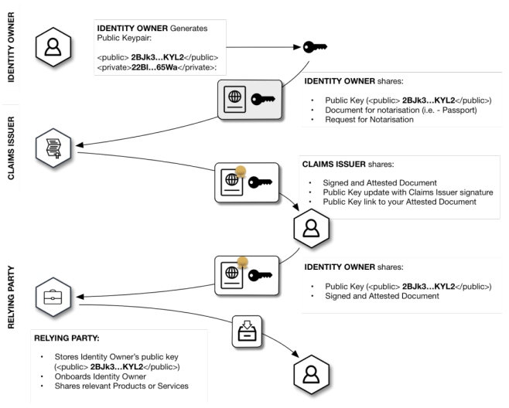

Slide 8
SelfKey For A Company:
Identity claims and attestations are not limited to persons but can also apply to companies.
A company could manage all their documents from the identity wallet.
Using SelfKey, a company can do things that are currently burdensome such as opening a bank account.

Slide 9
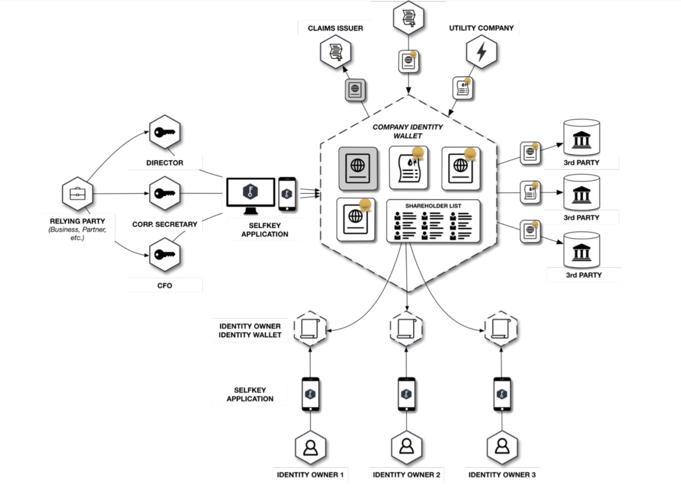

Slide 10
How SelfKey Works For a Verifier
There are a number of companies and institutions globally who issue (or could issue) claims on behalf of identity owners for use by relying parties.
Utility Companies-Who currently issue paper documents.
Bank-Who give letters of attestation.
Company Registries- Who issue paper documents.
With these attested documents, the owners of the company could instantly verify ownership by proving they hold the SelfKeys.

Slide 11
COMPARISION BETWEEN CENTRALIZED IDENTITY SYSTEM AND DECENTRALIZED IDENTITY SYSTEM OF SELFKEY IDENTITY OWNERS
User do not own or control the data.
Need to repeatedly go through numerous ongoing process.
Must share identity documents and can’t share a minimum of documents.
Cannot easily manage company documents or gather signatures for important documents.
The user has full consent and control over their identity and data.
Authenticate at multiple services using a single keypair stored in a wallet.
Can share minimum information.
Can easily sign documents and reach consensus as a company.

Slide 12
VERIFIERS
Don not monetize identity claims
They are unable to revoke a claim
They cannot quickly grant claims
Identity claims are sometimes fraudulent
Can monetize identity claims through key
Can revoke claims
It can quickly grant claims
Claims issued have more confidence

Slide 13
RELYING PARTIES
Must spend a lot of time and efforts on boarding clients to satisfy regulatory requirements
Have annoying board experiences with customers
No way to import customer data
Costly and challenging to be internationally compliant
Processes are driven by paper based and manual effort by compliance teams
Can quickly onboard identity owners
Can delight clients
Can benefit from economies of scale
Can be internationally compliant
Processes are driven by key and checked by RP’s

Slide 14
OVERALL SYSTEM FEATURES AND BENEFITS
Vast amounts of data sits in a vast large silo
Reward for hackers is greater, thus bigger target
Proprietary and Secretive
Creates monopolies of data
No value return to the user
Owned and controlled by single party
Single point failure
Distributed network allows for multiple small storages
Reward for hack penetration is low
Users centric and user driven
It is an open source of data with the user
No single point of failure
No centralized management or control
More transparent

Slide 15
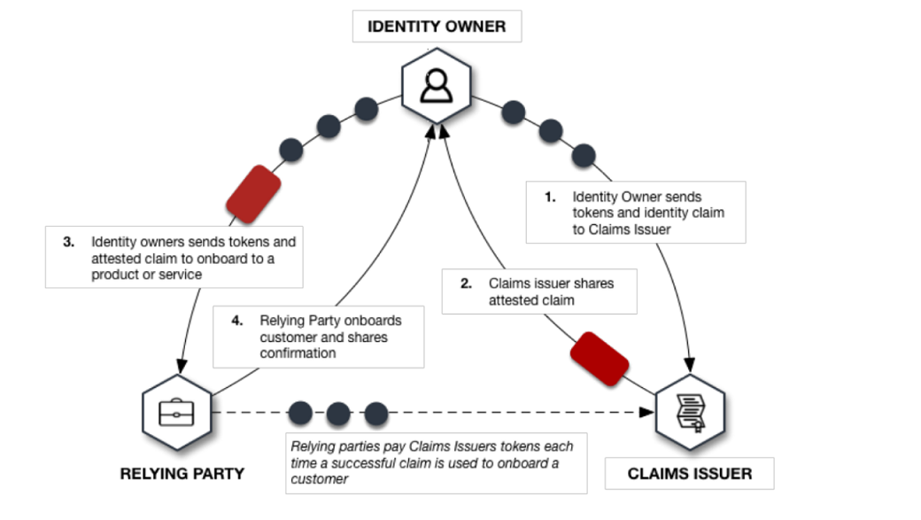
KEY TOKENS

Slide 16
USES OF KEY TOKENS
Bitcoin and digital asset exchange.
Token sales.
Money transfer services.
Resident permit applications for more than 50 countries.
International insurance applications.
E wallets.
Gold, diamonds and other precious metals and stones purchase and storage information.

Slide 17
Self key as a block chain:
Data are kept out of the transaction ledgers altogether by replacing them with an encrypted reference to the data – a “hash”.
Hashing means taking an input string of any length and giving out an output of a fixed length.
In the context of cryptocurrencies like Bitcoin, Bitcoin uses SHA-256 hashing algorithm
The use of hashes also helps address the fact that blockchain technology is structured to keep a permanent, immutable record of all transactions.

Slide 18
What is Blockchain?
Blockchain is a shared immutable ledger for recording the history of transactions.
Self Key is a blockchain based Identity System that allows individuals and companies to truly own, control and manage their digital identity.
Data will flow from one place to another through Https, and work is being done on P2P messaging protocols.

Slide 19
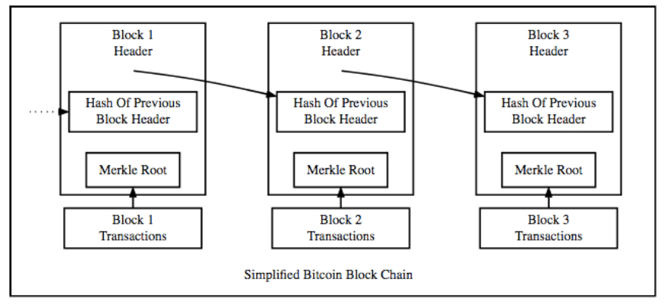
structure of the blockchain:

Slide 20
the layperson can be assured that:
Data only moves upon consent.
Data Privacy is paramount and data is never shared by the foundation with anyone
Each identity transaction uses encryption

